Slide 1


Creating Computable Knowledge from Unstructured Information
Cristiana Dinea | NVIDIa
Virginia aDAMS | NVIDIA

Slide 2
AGENDA
Why knowledge extraction?
Baseline implementation
Opportunities for improvements
Conclusion
Next steps

Slide 3
Why knowledge extraction?

Slide 4
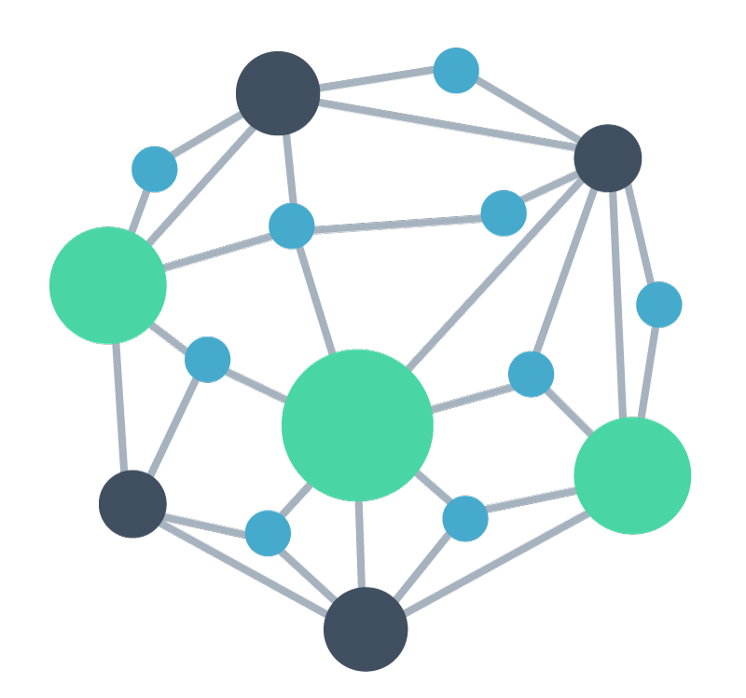


Why knowledge extraction
Creating Computable Knowledge from Unstructured Information
Custom Pre-Trained NLP Models
Extract Entities using Named Entity Recognition
Co-Reference Resolution, Negative Detection
Biomedical literature
Knowledge graph population, Querying
Relation Extraction
Relationship Canonicalization
Entity Linking to an Ontology
Trials data
Knowledge Graph Population
Semantic search applications, Ranker/Retriever
Integrated Information Retrieval and Search
Notes:
A typical knowledge extraction pipeline proceeds in a stepwise fashion, first by ingesting datasets of interest, then extracting entities of particular interest – such as a disease, a diagnosis, a test, a drug, or an intervention – then understanding how those entities are related to each other. For example, we might consider that a particular drug can be understood to be contraindicated with another drug, interact with a particular protein or biological pathway, or typically lead to a certain set of side effects. Importantly, these entities and relations can be richly described in English and any other language, and so variations in their representations in free text information present a challenge if we are to link the assembled knowledge from our document sources together. Entity linking, where we define a particular schema or ontology and discover the relationships between the free text representation of an idea to a particular reference entity defined in an ontology. An example of this might be myocardial infarction and heart attack, two ways of representing the same concept depending on the level of technical jargon and detail provided in a document.
Finally, the extracted entities, relationships, and fixed representations linked to an ontology can power a variety of downstream applications, including populating and querying knowledge graph databases, or implementing semantic search applications over your data.

Slide 5
Baseline implementation

Slide 6
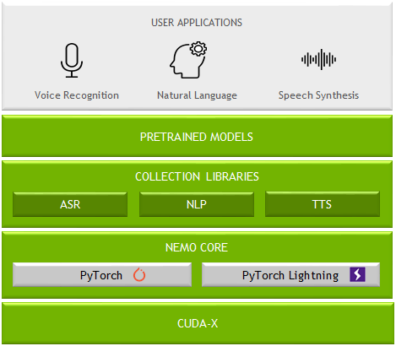
NVIDIA NEMO
Toolkit for Building SOTA Conversational Models
DL-Based Speech & Language Understanding Models
Include Semantic Checking for Correct-by-Construction Architectures
Support Expanding Set of Languages:
8 for ASR
5 for NLU
Open-Sourced
Integrated with PyTorch & PyTorch Lightning
Easy-to-Use APIs
Optimized Training Performance
100+ Pre-Trained GPU-Optimized Checkpoints
Scale to 1000s of NVIDIA GPUs
https://ngc.nvidia.com/catalog/containers/nvidia:nemo
https://github.com/NVIDIA/NeMo
Notes:
NVIDIA NeMo is NVIDIA’s open-source research-grade framework and toolkit for building state of the art conversational AI models, including for applications natural language understanding like biomedical and clinical BERT classification tasks. Although today we are focused on text, for those interested, NeMo provides state-of-the-art automatic speech recognition technologies out of the box, important for many of the transcription, telehealth, and call center applications that we discussed at the very beginning of this presentation.
NeMo makes it easy to start from a pre-trained checkpoint, pull a configuration for a particular downstream task implementing modern best practices for fine-tuning, point the model at your fine-tuning dataset, and benchmark/investigate and tune performance all within a framework that will be familiar to pytorch and pytorch-lightning users. Under the hood, NeMo implements several performance optimizations for training BERT models, including automatic mixed precision support and distributed multi-node multi-gpu support.
The NeMo collections library is extensive, and even interopates with HuggingFace. The NLP collection hosted on NGC contains several Biomegatron models, which is where we will start our investigation of Named Entity Recognition, Relation Extraction, and Entity Linking.

Slide 7
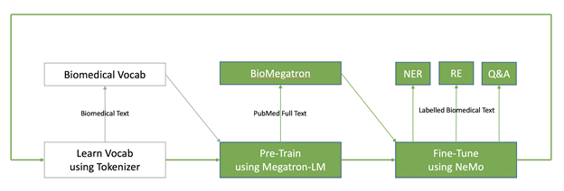
BioMegatron
State-of-the-Art Biomedical Pre-Trained Transformer Models
Largest biomedical language model trained (345M, 800M, 1.2B parameter variants)
Pre-trained from scratch on 6.1B words from PubMed
Using scientific biomedical vocabulary
Straightforward fine-tuning with NVIDIA NeMo for NER, RE, or Q&A tasks
Notes:
NVIDIA has recently applied Megatron BERT pre-training to both biomedical and clinical text. In 2020 we released BioMegatron, a free and open source set of pre-trained checkpoints for biomedical classification tasks. This model remains today among the most popular pre-trained models we have built for the community. It was trained on 6.1B words from the permissively licensed portion of PubMed using a custom domain-specific biomedical vocabulary. BioMegatron is available out of the box in NVIDIA NeMo for downstream task-specific fine-tuning, which we will cover later in the presentation.

Slide 8
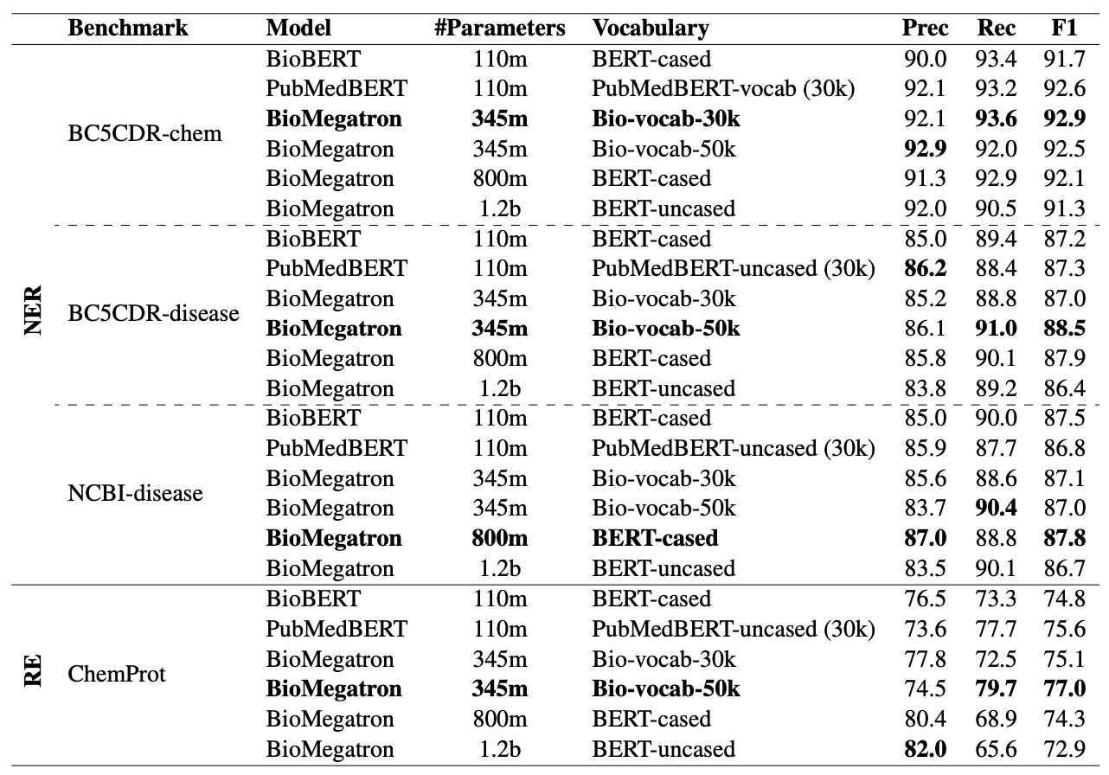
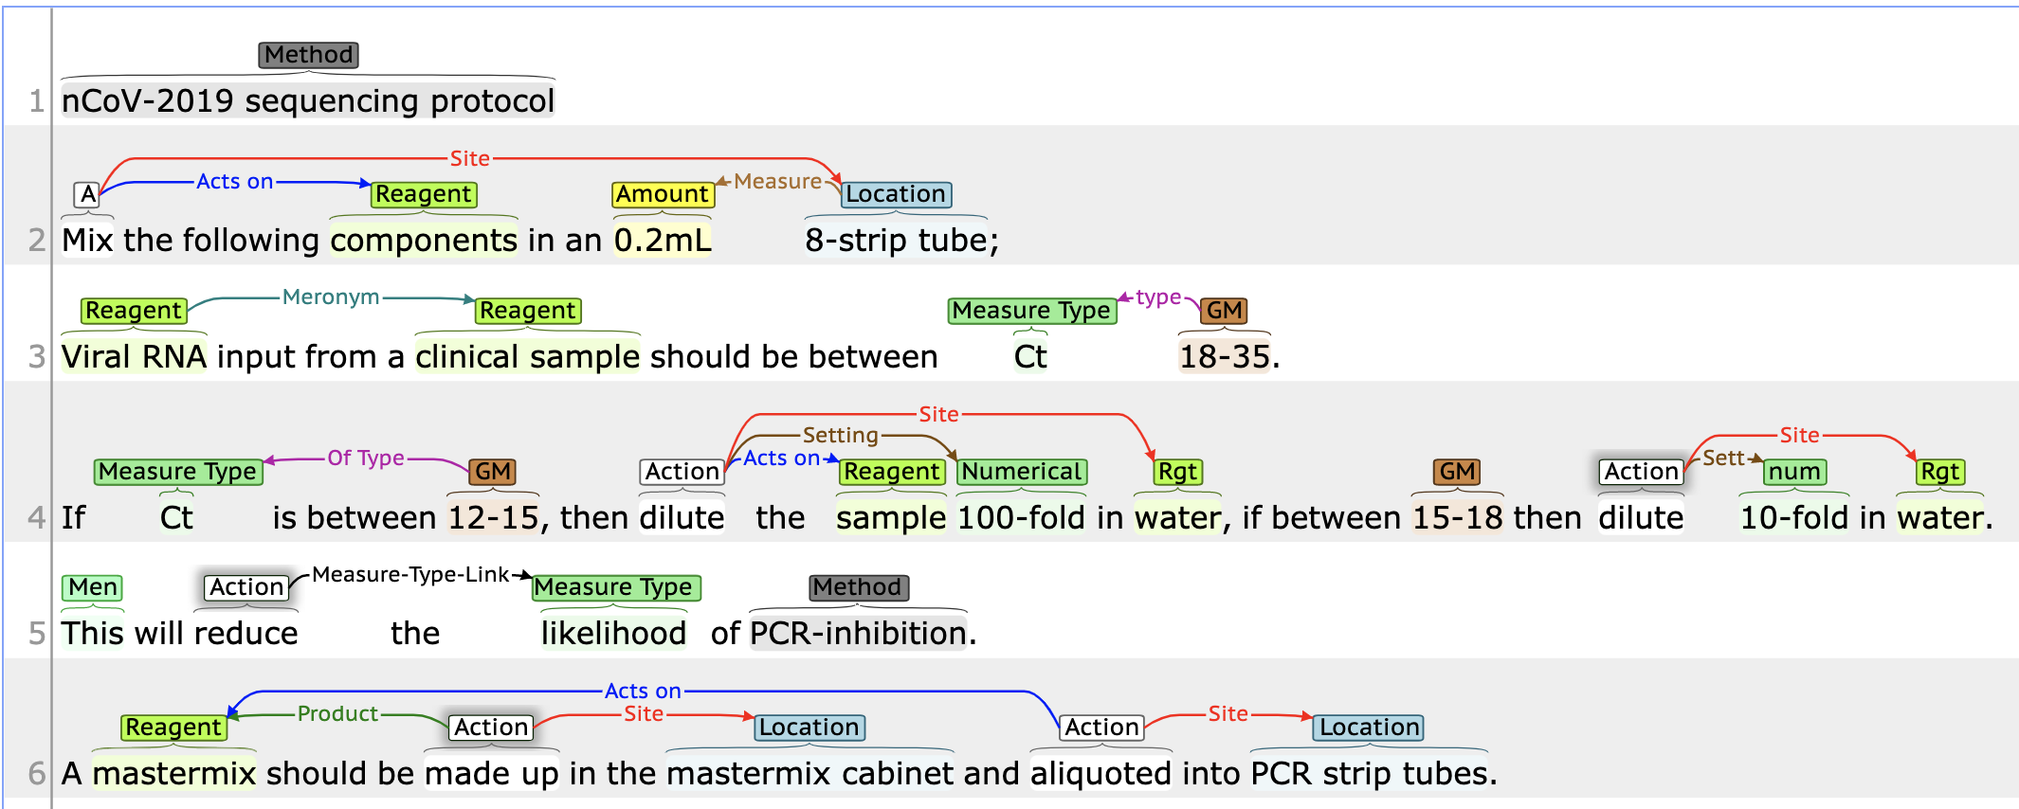
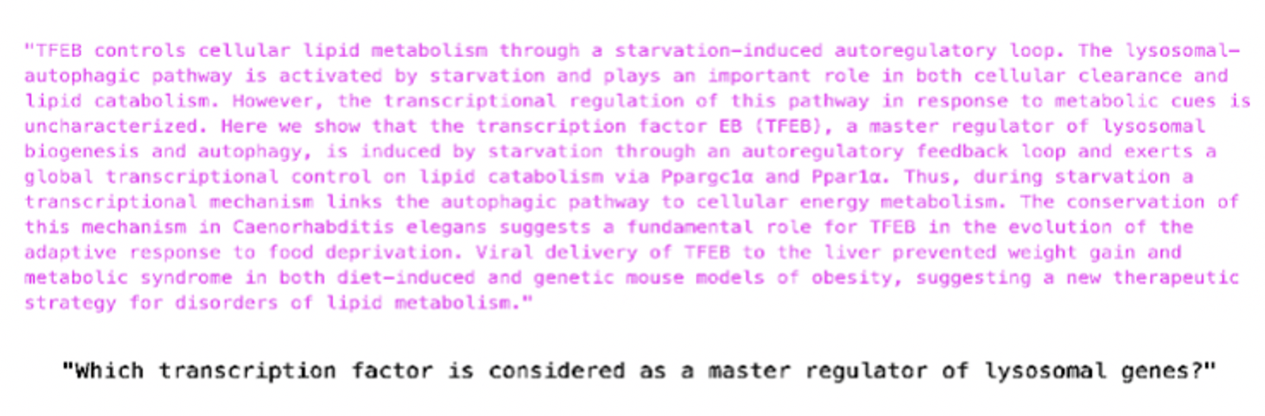
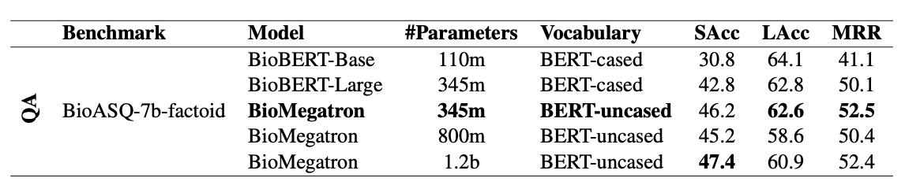
SOTA biomedical NLP breakthroughs
BioMegatron Achieves State-of-the-Art
Named
Entity
Recognition
Relation
Extraction
Question
Answering
Shin, H.-C. et al. BioMegatron: Larger Biomedical Domain Language Model. arXiv [cs.CL] (2020)
Notes:
We benchmarked named entity recognition, relation extraction, and extractive question answering using BioMegatron fine-tuned using canonical benchmarks in the field, including BC5CDR-chem, a dataset from the BioCreative V challenge that consists of labeled diseases, chemicals and their relationships; ChemProt, a dataset of almost 2000 annotated PubMed articles with both chemical-protein itneractions annotated by domain expects from the BioCreate VI challenge, and BioAsk factoid, a dataset containing training and test biomedical questions along with gold standard answers.
----
Task 7b will use benchmark datasets containing training and test biomedical questions, in English, along with gold standard (reference) answers. The participants will have to respond to each test question with relevant concepts (from designated terminologies and ontologies), relevant articles (in English, from designated article repositories), relevant snippets (from the relevant articles), relevant RDF triples (from designated ontologies), exact answers (e.g., named entities in the case of factoid questions) and 'ideal' answers (English paragraph-sized summaries). 2747 training questions (that were used as dry-run or test questions in previous year) are already available, along with their gold standard answers (relevant concepts, articles, snippets, exact answers, summaries). At least 500 new test questions will be used this year. All the questions are constructed by biomedical experts from around Europe.
BC5-chem; The corpus consists of three separate sets of articles with diseases, chemicals and their relations annotated. The training (500 articles) and development (500 articles) sets were released to task participants in advance to support text-mining method development. The test set (500 articles) was used for final system performance evaluation.
ChemProt BC6; Consists of 1,820 PubMed abstracts with chemical-protein interactions annotated by domain experts and was used in the BioCreative VI text mining chemical-protein interactions shared task.
F1 – Measures average overlap between prediction and ground truth
Sacc – strict accuracy, exact match of strings between predictions and gold standard answers. Top 1 exact answers.
Lacc – rate of exact answers in top 5 predictions
MRR – mean reciprocal rank, mean rank on the top 5 answers.

Slide 9
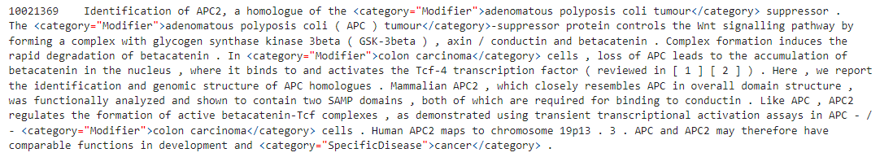
Named entity recognition (NER)
BioMegatron Fine-Tuning for Disease Extraction from LitCoin Challenge Dataset
Starting from BioMegatron pre-trained checkpoint, fine-tune the model to to find all the nodes or biomedical entities (position in text and BioLink Model Category)
Reference implementation in NVIDIA NeMo achieves 98.8% weighted average F1 score after <20 minutes of fine-tuning on a NVIDIA V100 GPU.
Dataset can be converted into standard IOB tagging format with standard pre-processing tools distributed with NeMo.
Notes:
The LitCoin Natural Language Processing (NLP) Challenge seeks to spur innovation by rewarding the most creative and high-impact uses of biomedical, publication-free text to create knowledge graphs that can link concepts within existing research to allow researchers to find connections that may have been difficult to discover without them. This challenge is part of a broader conceptual initiative at NCATS to change the “currency” of biomedical research. NCATS held a Stakeholder Feedback Workshop in June 2021 to solicit feedback on this concept and its implications for researchers, publishers and the broader scientific community.
This challenge brings together government, medical research communities and data scientists to create data-driven knowledge graphs that consolidate medical scientific data across domains. With an approximately four (4)-month development cycle for the challenge, data scientists will be challenged to develop NLP systems with the ability to identify concepts from a biomedical publication and link them together into relationships to create well-linked and carefully defined knowledge graphs for each publication
NCATS will share with the participants an open repository containing abstracts derived from published scientific research articles and knowledge assertions between concepts within these abstracts. The participants will use this data repository to design and train their NLP systems to generate knowledge assertions from the text of abstracts and other short biomedical publication formats
For Named Entity Recognition, we will start from a standard public dataset from the National Center for Biotechnology Information (NCBI), a set of PubMed abstracts annotated by expert labelers that contains specific entity types related to disease. It is distributed in a standard HTML format which can be easily converted into standard IOB tagging using tools distributed with NeMo. An out of the box pipeline in NeMo is available, including an NER TextClassification task and reference configuration demonstrated in a Jupyter notebook and accessible through our NGC NeMo container. It achieves nearly 99% weighted F1 accuracy on this task after fine-tuning for less than 20 minutes on an NVIDIA V100 GPU, as a baseline reference.

Slide 10
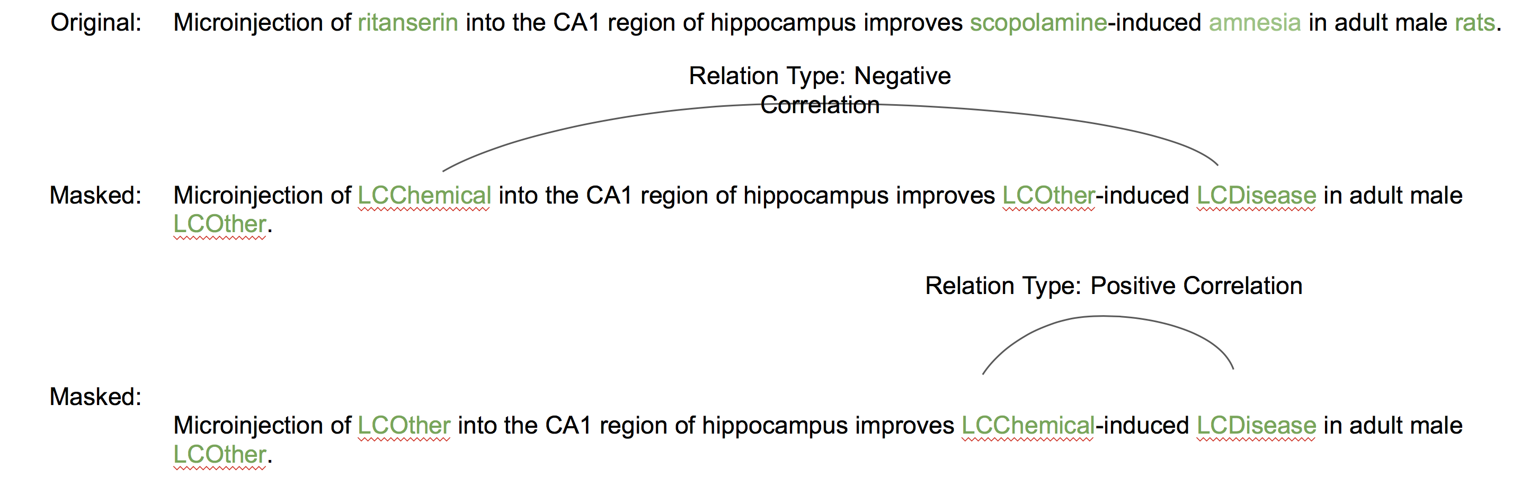
Relation Extraction (RE)
BioMegatron Fine-Tuning to Extract Entity Relations from LitCoin Dataset
Starting from BioMegatron pre-trained checkpoint, fine-tune the model to perform a sentence classification task to the to find all the relationships between annotated nodes in a given abstract (pair of nodes, BioLink Model Predicate and novelty).
Reference implementation in NVIDIA NeMo achieves 85.05% weighted average F1 score after 30 minutes of fine-tuning on a NVIDIA V100 GPU.
Notes:
For our demo of biomedical relation extraction, we focus on the ChemProt from the BioCreative 6 challenge, which consists of about 1800 PubMed abstracts with chemical-protein interactions annotated by a domain expert. Starting from a BioMegatron pre-trained checkpoint, our reference implementation in a Jupyter notebook distributed with NeMo and available in the NeMo NGC container and on our open source Github repository, performs a multi-label classification task for each of 5 defined relationships between entities and achieved a weighted average F1 score of about 90% after 30 minutes of fine-tuning on an NVIDIA A100 GPU.

Slide 11
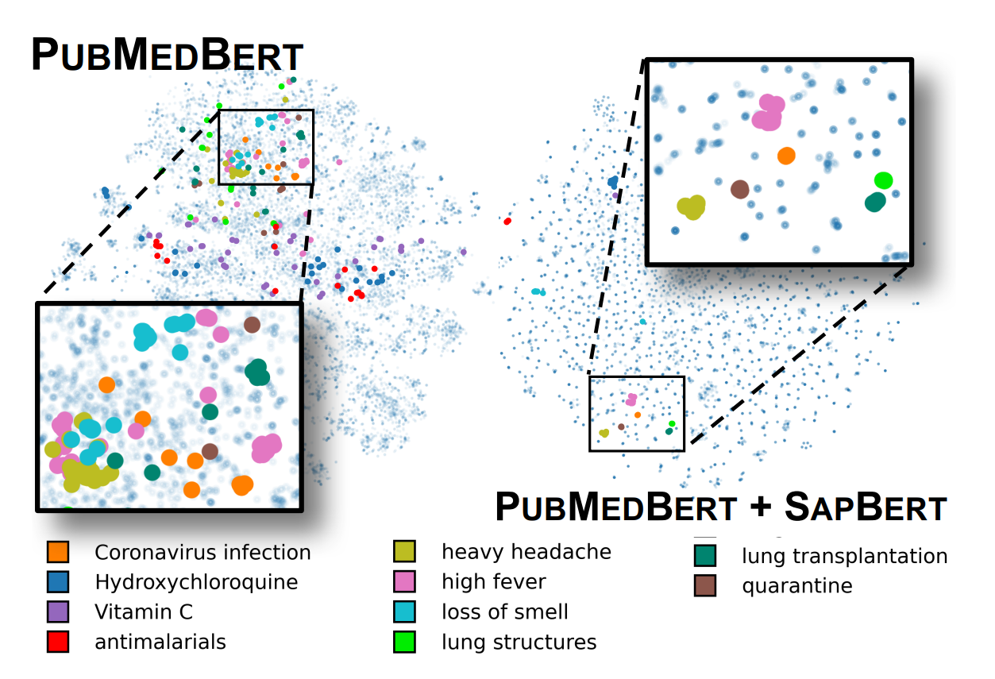
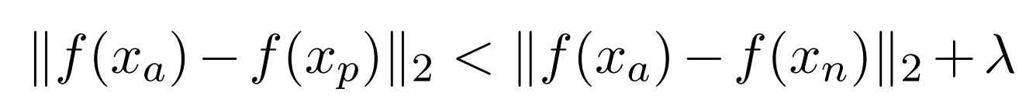
Self-alignment pre-training
Generate embedding representations clustered directly for entity linking in UMLS
End-to-End Medical Entity Linking
Goal is to design a novel objective that clusters synonyms of the same concept
Hard positive pairs have the same entity ID but are farther away from each other in vector space than the closest negative pair by some margin
Pairwise cosine similarity of BERT-based representations, adopt a multi-similarity loss within each mini-batch
Liu, F., Shareghi, E., Meng, Z., Basaldella, M. & Collier, N. Self-Alignment Pretraining for Biomedical Entity Representations. arXiv [cs.CL] (2020)
Notes:
The general idea is to coax the model to align like synonyms in the embedding space, such that, as an example, all relevant synonyms for Coronavirus infection (for example Vitamin C, ascorbic acid, one of dozens of brand names for supplements if desired), are clustered and can therefore be easily extracted with the entity ID. The technique can be applied to any arbitrary BERT model, such as PubMedBERT or BioMegatron. The idea behind self-alignment pre-training combines sampling “hard pairs”, that is, those entities which have the same entity ID but are far away from each other in the embedding space. A multi-similarity loss is then used to coax each mini-batch to align those pairs in the embeddings.
LitCoin challenge:
Joint sponsorship from the National Center for Advancing Translational Sciences (NCATS), the National Center for BioTechnology Information (NCBI), and the NASA Tournament Lab.
Explicit goal to improve linkages and maps relating scientific discoveries in literature, targeting knowledge graphs and open data repositories used to identify gaps and accelerate medical/biomedical research.
Two parts
Phase 1: November 9, 2021 – December 23, 2021
Given an abstract, find all nodes (biomedical entities) corresponding to a BioLink Model category (extensive python library support here).
NER + link to concept ontology, uniquely identified as one and only one of
DiseaseOrPhenotypicFeature, ChemicalEntity, OrganismTaxon, GeneOrGeneProduct, SequenceVariant, CellLine
Provided training dataset of abstracts (including metadata, PubMed ID, title), entities (structured as offset begin/end positions, types, ontology linkages)
Ontology linkages (used in Phase 2) from NCBI Gene, MEDIC (MESH + OMIM), MESH, RS# in dbSNP, NCBI Taxonomy, and Cellosaurus for each of the types indicated above, respectively.
Phase 2: December 27, 2021 – February 28, 2022
Given an abstract and extracted nodes, find all relationships between nodes corresponding to a BioLink Model Predicate.

Slide 12
Let’s get started!
All resources here https://github.com/BioITHackathons/Creating-Computable-Knowledge-from-Unstructured-Information
AWS setup : use AWS credits to launch V100/A100 nstances (p3/p4d instances)
Once instance is launched, connect to your instance using its Public DNS
example : ssh -i "bioitgen.pem" ubuntu@ec2-3-226-251-173.compute-1.amazonaws.com
git clone git@github.com:NVIDIA/NeMo.git --branch main
git clone https://github.com/BioITHackathons/Creating-Computable-Knowledge-from-Unstructured-Information
sudo DOCKER_BUILDKIT=1 docker build -f Dockerfile -t nemo_containers:nemo_main .
docker run --gpus all -it --shm-size=8g -p 8888:8888 -p 6006:6006 --ulimit memlock=-1 --ulimit stack=67108864 nemo_containers:nemo_main
set jupyter notebook credentials inside the container (either hashed or automatic per https://jupyter-notebook.readthedocs.io/en/stable/public_server.html )
set up SSL
mkdir certs
cd certs
sudo openssl req -x509 -nodes -days 365 -newkey rsa:2048 -keyout mycert.pem -out mycert.pem
sudo chown $USER:$USER mycert.pem
cd ..
Modify jupyter_server_config.py
c = get_config()
c.ServerApp.certfile = u'/home/ubuntu/certs/mycert.pem’
c.ServerApp.ip = '*' c.ServerApp.password = u'YOUR_PASSWORD’
c.ServerApp.port = 8888

Slide 13
Let’s get started!
jupyter lab --no-browser
Open https://PUBLIC_IP_AWS_INSTANCE:8888/?token=77d8d813072c113240e7cf15a7c95089f45f8abf5b82e4d6 in your browser (make sure you have set up TCP with 8888 in you security groups)
Navigate through labs

Slide 14
Let’s get started!
X-labs setup
Go to http://courses.nvidia.com/join to create/login to your DLI account
Go to courses.nvidia.com/dli-event
Add CLARA_NLP_MA22 as an event code , launch the V100 GPU instance, navigate through labs

Slide 15
Opportunities for Improvement
O

Slide 16
Performance analysis
NER
RE
EL
Different approach – 0-shot, P tuning

Slide 17
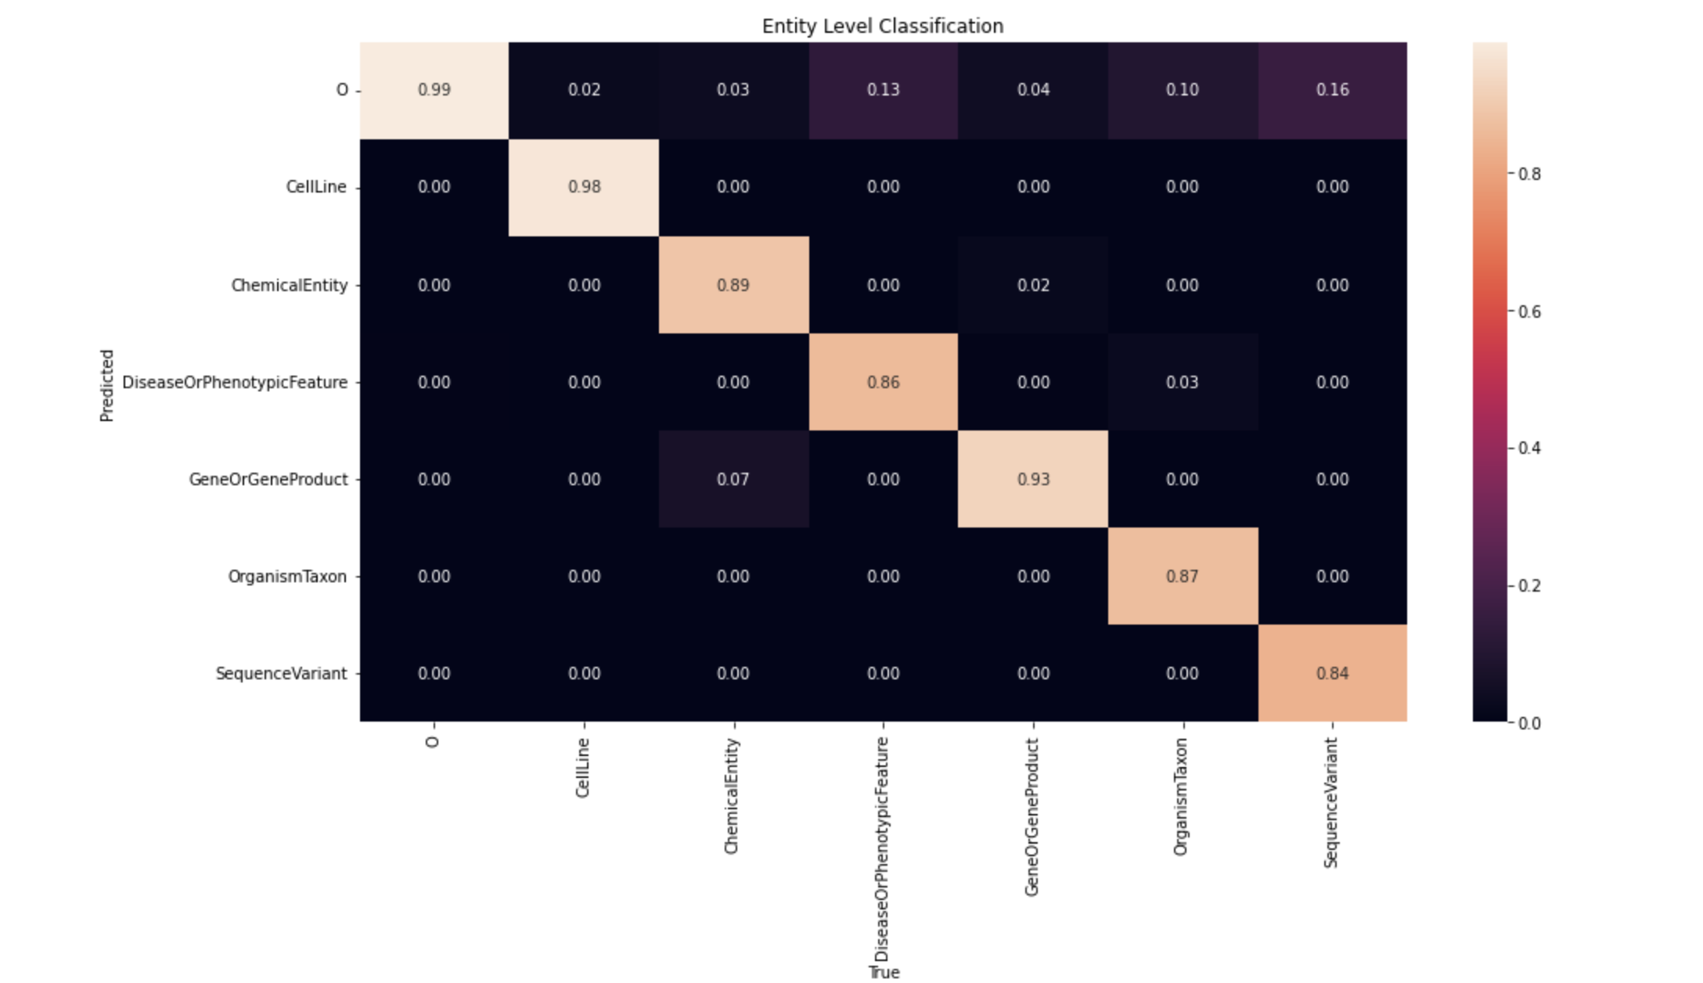
NER

Slide 18
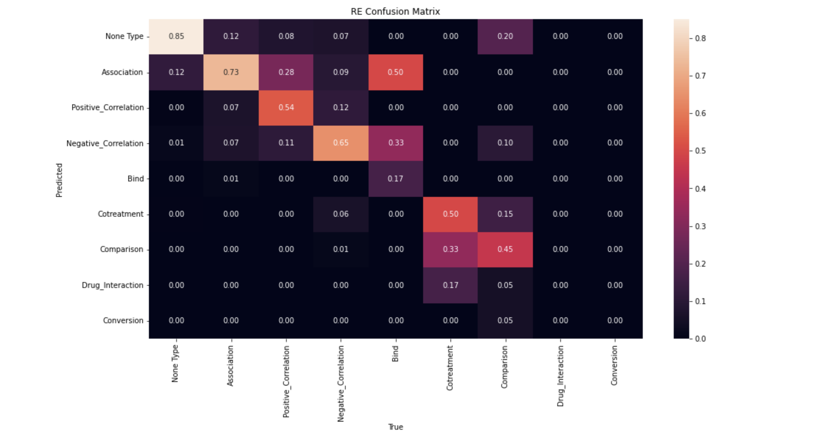
RE

Slide 19
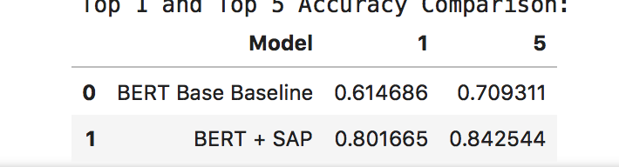
Entity linking

Slide 20
large language modeling
Towards a Label-Free Future for Natural Language Understanding
Old Way
New Way
Needs Labelled data
Cost of data collection/labelling
Legal/Privacy concerns around using data
1 model per task results in
Increased model development/tuning cost
Increased operational costs
Increased money spent on sourcing data
Relatively Limited generalization
Computationally cheaper (~300 Million parameters)
Does not need labelled data
Single generic model can do more than one tasks
More generalized: in addition to language also learns higher level concepts, styles, etc.
Computationally Expensive (~500 Billion parameters)
Healthcare and life sciences data benefits uniquely from label free model inference!
Siloed datasets Privacy considerations
Dataset bias, balance
No labeling resources
Hundreds of target ontologies, schemas
Constantly evolving use cases

Slide 21


large language modeling training
Train a very deep, “huge” model
Zero shot, few shot, novel model tuning enable label free tasks
Q: What procedures are reflected in this abstract? “Despite sophisticated physical examination and laboratory support, diagnosis of acute appendicitis remained challenging in clinical practice…”
General Knowledge
Biomedical Literature
‘A: Appendectomy and Ultrasound’
Clinical Reports
GitHub
Lembcke, B. Ultrasonography for acute appendicitis - the way it looks today. Z. Gastroenterol. 54, 1151–1165 (2016)

Slide 22
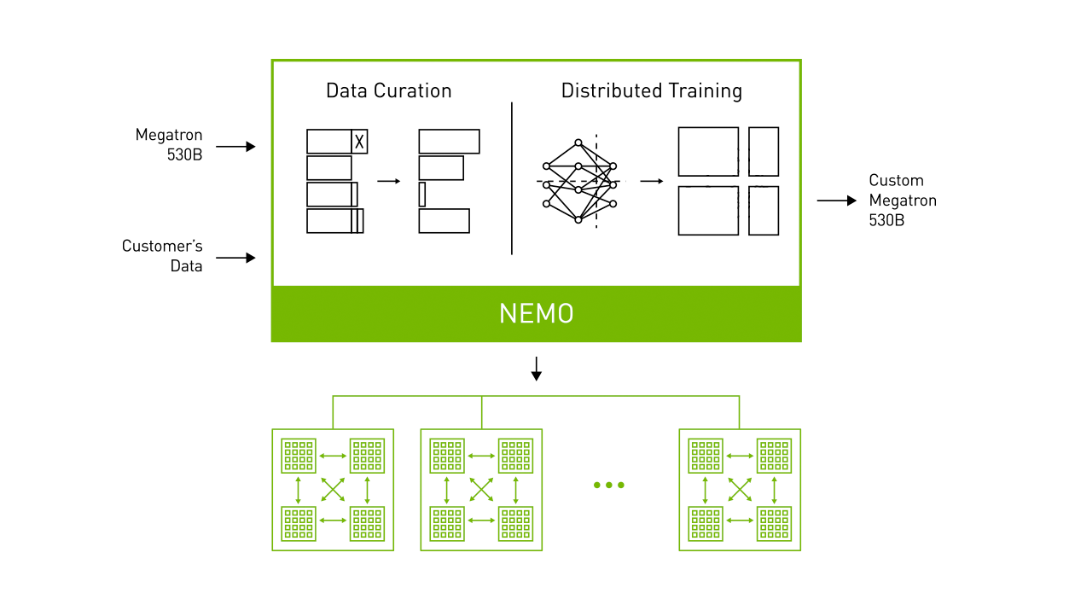
New: NeMo MEGATRON
Accelerated Framework For Training Large Scale NLP Models
Scale To Models with Trillions of Parameters​
Automated Data Curation for Training​​
Pipeline, Tensor & Data Parallelism​
20B Parameter Model in 1 month on DGX SuperPod
Optimized for DGX SuperPod​
Sign up for Early Access
https://docs.nvidia.com/deeplearning/sdk/mixed-precision-training/index.html
Notes:
We have recently added GPT-3 pre-training and prompt tuning functionality directly into NeMo through a new product we are calling NeMo Megatron, which is currently available in early access. All of the acceleration, parallelization, and innovation that was previously available only through the Megatron codebase is now straightforward to leverage directly in NeMo. So no matter if you are working with small scale models out of the box or training trillion parameter models on large DGX SuperPod clusters, the same software provides an end-to-end solution for pre-training to research experimentation, model tuning, and validation.

Slide 23
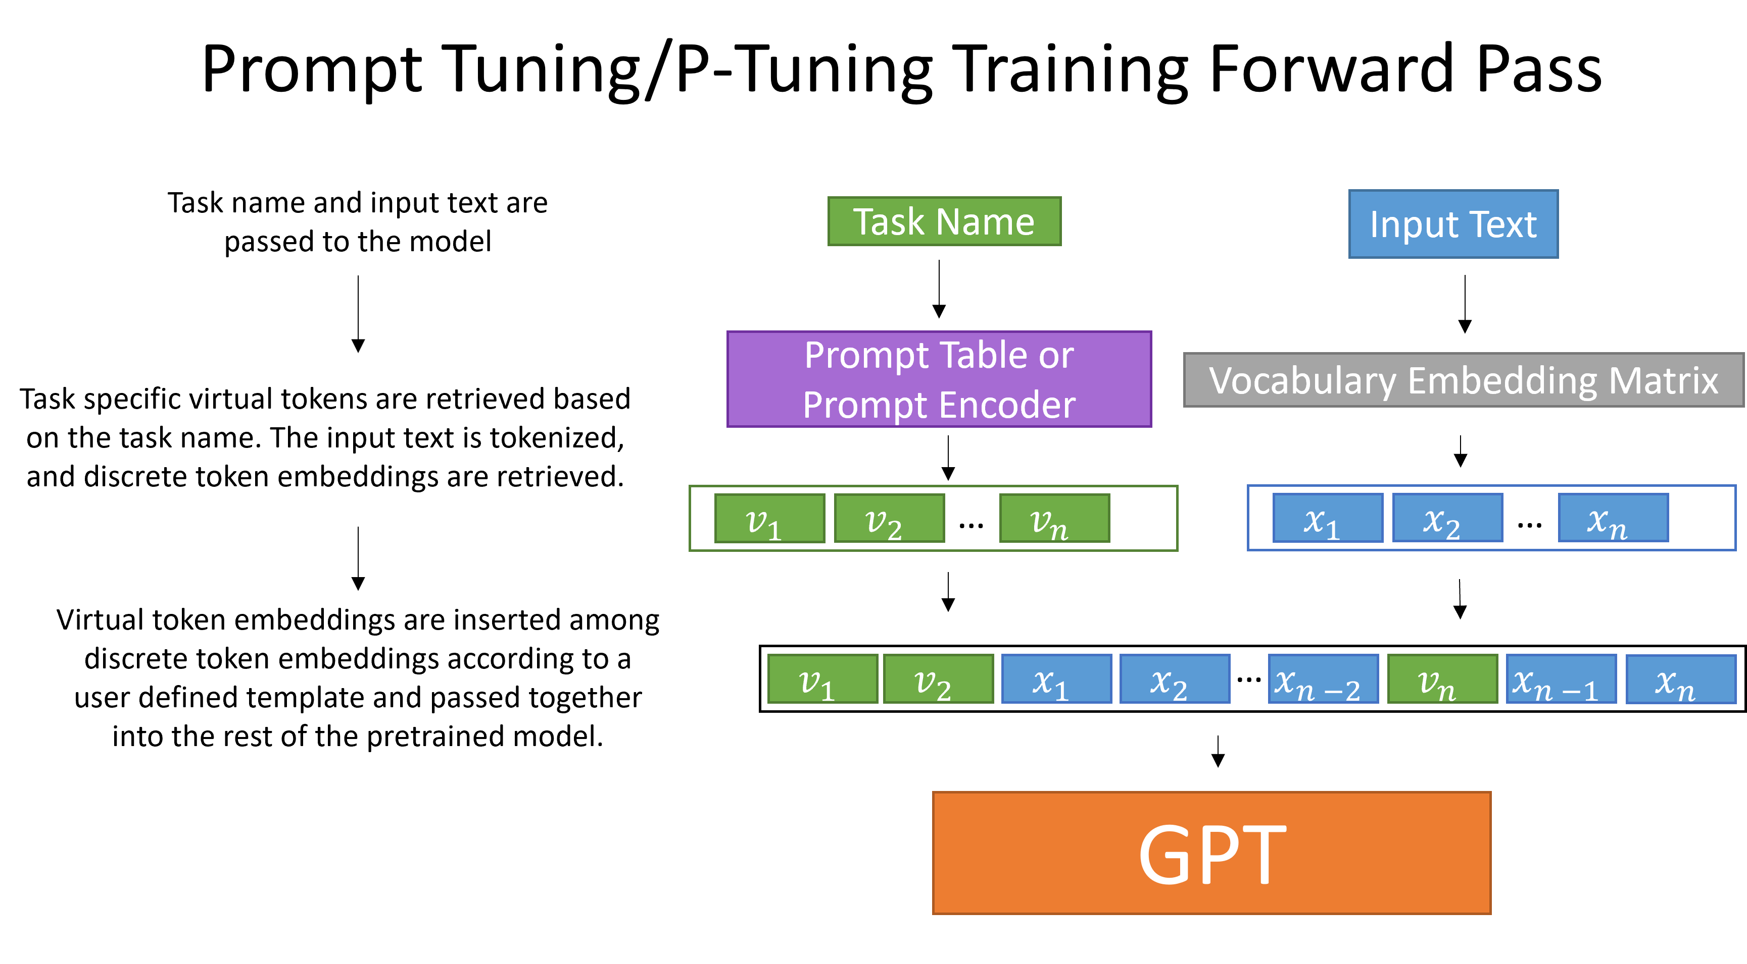

Slide 24
Opportunities for improvements

Slide 25
conclusion

Slide 26
Next steps

Slide 27
NVIDIA CONFIDENTIAL SLide
Optional Subtitle
Bullet text (if bullet symbol is not needed, turn to “None” on “Home” tab in “Paragraph” styles)
Secondary bullet text
Use 40 pt. Trebuchet font
Keep points short and informative
Example of highlighted text

Slide 28
Two column layout
Optional Subtitle
Text goes here
Text goes here
Text goes here
Text goes here
Text goes here
Text goes here
Text goes here
Text goes here
Text goes here
Text goes here

Slide 29
NVIDIA Two column confidential slide
Optional Subtitle
Text goes here
Text goes here
Text goes here
Text goes here
Text goes here
Text goes here
Text goes here
Text goes here
Text goes here
Text goes here

Slide 30
Coding title
Coding Subtitle
Bullet text (if bullet symbol is not needed, turn to “None” on “Home” tab in “Paragraph” styles)
Secondary bullet text
Use 40 pt. Trebuchet font
Keep points short and informative
Example of highlighted text

Slide 31
NVIDIA CONFIDENTIAL SLIDE
Coding Slide
Bullet text (if bullet symbol is not needed, turn to “None” on “Home” tab in “Paragraph” styles)
Secondary bullet text
Use 40 pt. Trebuchet font
Keep points short and informative
Example of highlighted text

Slide 32
“Quote example. Trebuchet 100 pt. Use with shorter quotes.”
Quote Source, Trebuchet 40 pt.

Slide 33
Color palette
Black
0 / 0 / 0
Light Gray
205 / 205 / 205
Primary and
Neutral Colors
NVIDIA Green
RGB: 118 / 185 / 0
Medium Gray
140 / 140 / 140
Dark Gray
94 / 94 / 94
Secondary
Colors
Emerald
0 / 133 / 100
Amethyst
93 / 22 / 130
CPU Blue
0 / 113 / 197
Garnet
137 / 12 / 88
Fluorite
250 / 194 / 0

Slide 34
Pie chart
Source: Source information is 24 pt, italic

Slide 35
bar chart
Y-axis text goes here
X-axis text goes here
Source: Source information is 24 pt, italic

Slide 36


line chart
NOTE: Link All Original Data for Charts
Y-axis text goes here
X-axis text goes here
Source: Source information is 24 pt, italic

Slide 37
Table sample
 | Title Goes Here | Title Goes Here | Title Goes Here
Text Goes Here | Text
Text Goes Here
Text Goes Here
Text Goes Here
Text Goes Here

Slide 38
1 panel layout
Optional Subtitle
Image title goes here
Optional Subtitle

Slide 39
2 panel layout
Optional Subtitle
Image title goes here
Image title goes here
Optional Subtitle
Optional Subtitle

Slide 40
2 panel alternate layout
Optional Subtitle
Image title goes here
Image title goes here
Optional Subtitle
Optional Subtitle

Slide 41
3 panel layout
Optional Subtitle
Image title goes here
Image title goes here
Image title goes here
Optional Subtitle
Optional Subtitle
Optional Subtitle

Slide 42
4 panel layout
Optional Subtitle
Image title goes here
Image title goes here
Image title goes here
Image title goes here
Optional Subtitle
Optional Subtitle
Optional Subtitle
Optional Subtitle

Slide 43
4 panel alternate layout
Optional Subtitle
Image title goes here
Image title goes here
Image title goes here
Image title goes here
Optional Subtitle
Optional Subtitle
Optional Subtitle
Optional Subtitle

Slide 44
5 panel layout
Optional Subtitle
Image title goes here
Image title goes here
Image title goes here
Optional Subtitle
Optional Subtitle
Optional Subtitle
Image title goes here
Image title goes here
Optional Subtitle
Optional Subtitle

Slide 45
6 panel layout
Optional Subtitle
Image title goes here
Image title goes here
Image title goes here
Optional Subtitle
Optional Subtitle
Optional Subtitle
Image title goes here
Image title goes here
Image title goes here
Optional Subtitle
Optional Subtitle
Optional Subtitle

Slide 46
7 panel layout
Optional Subtitle
Image title goes here
Image title goes here
Image title goes here
Image title goes here
Optional Subtitle
Optional Subtitle
Optional Subtitle
Optional Subtitle
Image title goes here
Image title goes here
Image title goes here
Optional Subtitle
Optional Subtitle
Optional Subtitle

Slide 47
8 panel layout
Optional Subtitle
Image title goes here
Image title goes here
Image title goes here
Image title goes here
Optional Subtitle
Optional Subtitle
Optional Subtitle
Optional Subtitle
Image title goes here
Image title goes here
Image title goes here
Image title goes here
Optional Subtitle
Optional Subtitle
Optional Subtitle
Optional Subtitle

Slide 48
9 panel layout
Optional Subtitle
Image title goes here
Image title goes here
Image title goes here
Image title goes here
Image title goes here
Optional Subtitle
Optional Subtitle
Optional Subtitle
Optional Subtitle
Optional Subtitle
Image title goes here
Image title goes here
Image title goes here
Image title goes here
Optional Subtitle
Optional Subtitle
Optional Subtitle
Optional Subtitle

Slide 49
10 panel layout
Optional Subtitle
Image title goes here
Image title goes here
Image title goes here
Image title goes here
Image title goes here
Optional Subtitle
Optional Subtitle
Optional Subtitle
Optional Subtitle
Optional Subtitle
Image title goes here
Image title goes here
Image title goes here
Image title goes here
Image title goes here
Optional Subtitle
Optional Subtitle
Optional Subtitle
Optional Subtitle
Optional Subtitle

Slide 50
Title goes here
Optional Subtitle
Text goes here
Text goes here
Text goes here

Slide 51
Title goes here
Text goes here
Text goes here
Text goes here

Slide 52
Title goes here
Optional Subtitle
Text goes here
Text goes here
Text goes here

Slide 53
Title goes here
Text goes here
Text goes here
Text goes here

Slide 54
Title goes here
Optional Subtitle

Slide 55
Title goes here

Slide 56
Title goes here
// Functions that do amazing things
// are totally worth presenting!
func int code<blah>
{
int i = 123;
for (n=1; n<x; n++)
{
doSomethingCool(n,x);
}
return 0;
}
Optional Subtitle
Text goes here
Text goes here
Text goes here

Slide 57
ANNOUNCING Xxxxxxxx xxxxxxxxxxxx

Slide 58
EMBARGO
This presentation is embargoed until [month, day], 20xx at xx:xx [time zone]

Slide 59
EXample slides

Slide 60

LOGO TREATMENT
Logos are Full Color & Alphabetized

Slide 61
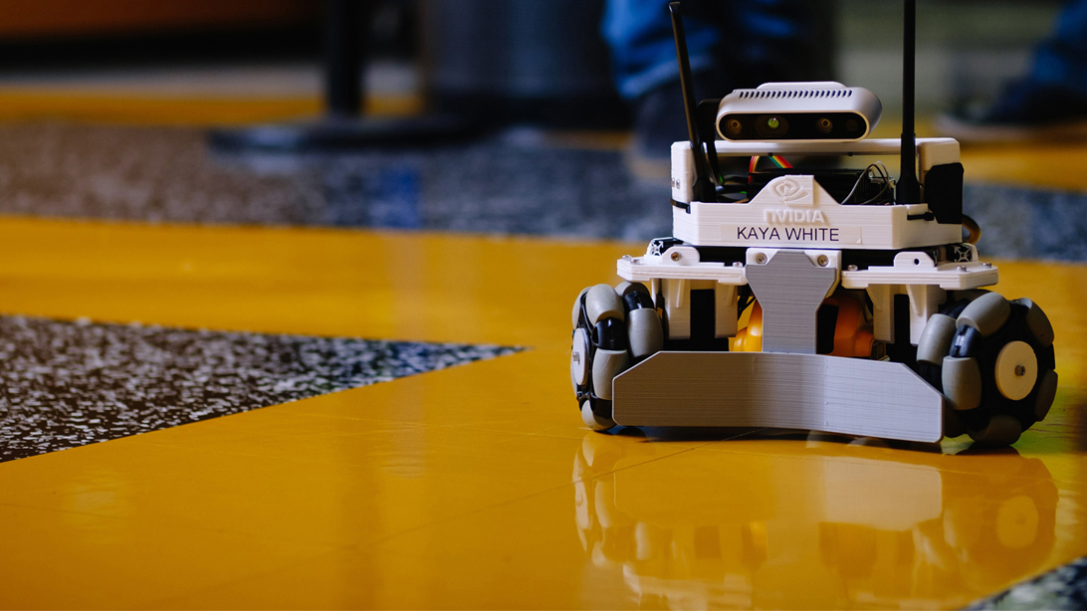

USE CASE STUDIES — EXAMPLE
Expand/shrink shaded gray box and text box based on amount of content
Move box and text based on image; avoid covering important components of visual
Line up partner logo to the baseline of NVIDIA logo and have same relevant sizing
Allow adequate spacing around content in relation to shaded gray box
Partner Logo Here

Slide 62
USE CASE STUDIES
Text goes here
Partner Logo Here

Slide 63
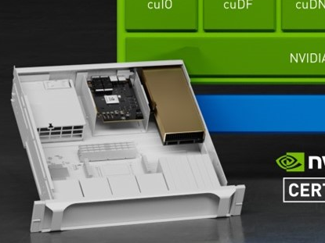
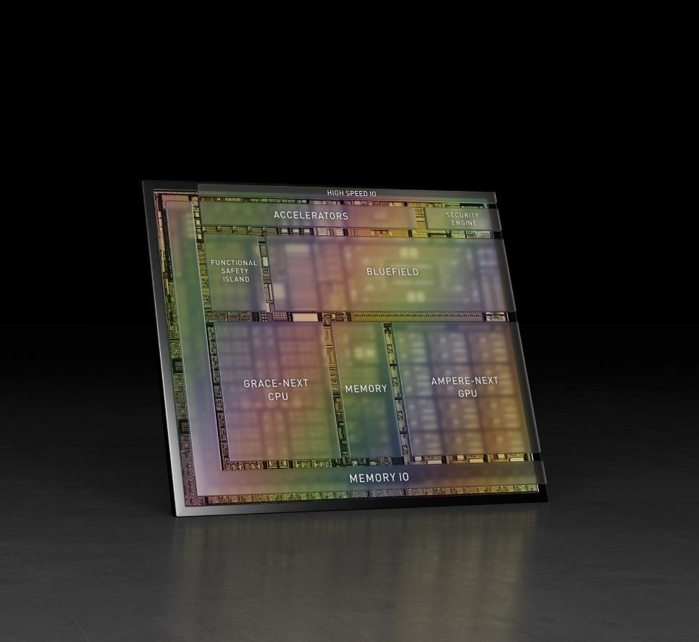
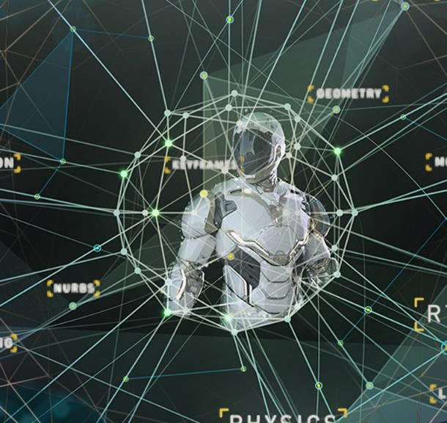
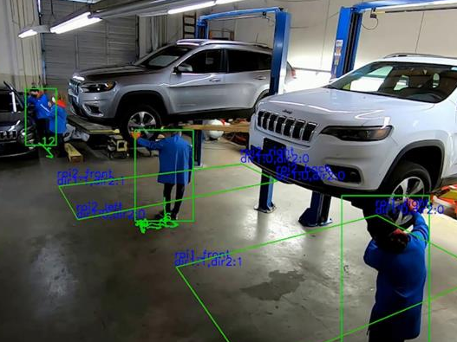
TIMELINE
With Images
TITLE GOES HERE
Supporting text here
TITLE GOES HERE
Supporting text here
TITLE GOES HERE
Supporting text here
TITLE GOES HERE
Supporting text here
2021
xxxx
xxxx
xxxx

Slide 64
COMPLEX TIMELINE
With Text
TEXT GOES HERE
Text goes here
TEXT GOES HERE
Text goes here
TEXT GOES HERE
Text goes here
TEXT GOES HERE
Text goes here
TEXT GOES HERE
Text goes here
TEXT GOES HERE
Text goes here
TEXT GOES HERE
Text goes here
Text goes here
Text
Text
Text
Text goes here
Text
Text
Text goes here
Text
Text
Text
Text
Text goes here
Text
Text
Text
Text
Text goes here
Text
Text
Text
Text
Text goes here
Text
Text
Text
Text
Sept. 2021
Oct.
Nov.
Dec.
Jan. 2022
Feb.
Mar.
Text
Text
Text
Text

Slide 65
VIDEO/DEMO TITLE

Slide 66

World map
Adjust Locations to Areas Desired
Helsinki
Santa Clara
Tokyo

Slide 67
assets

Slide 68
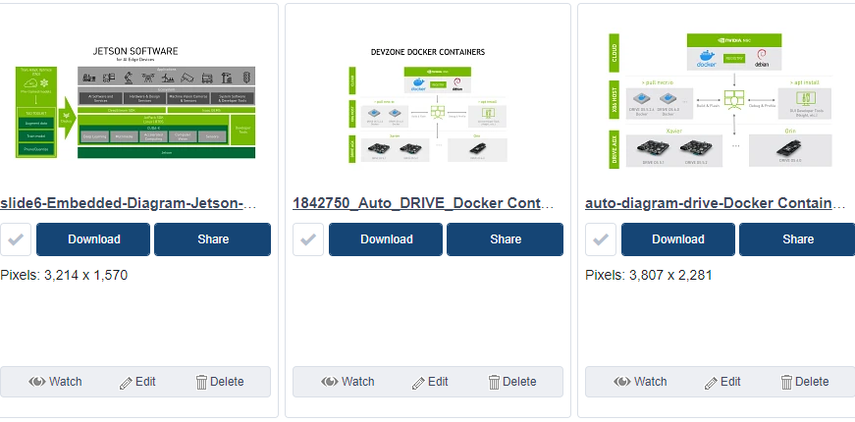
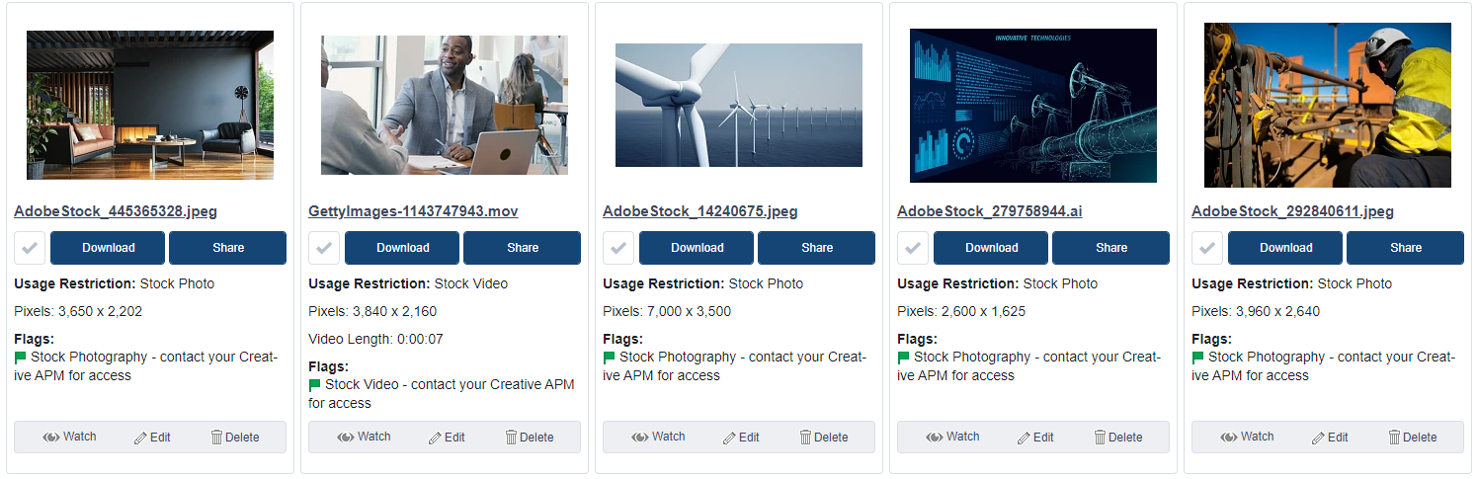
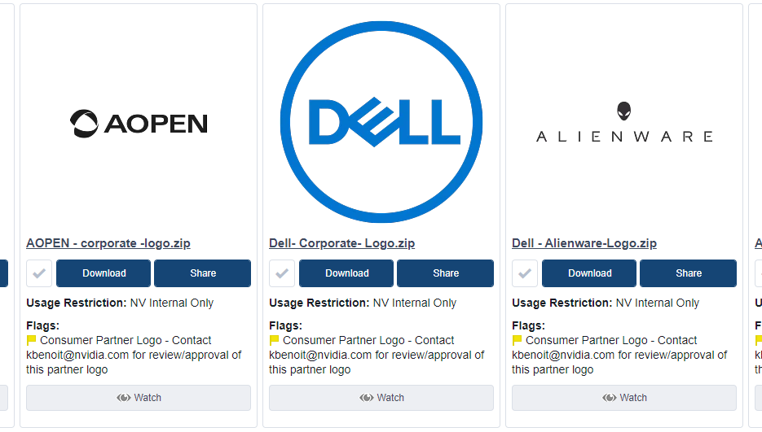
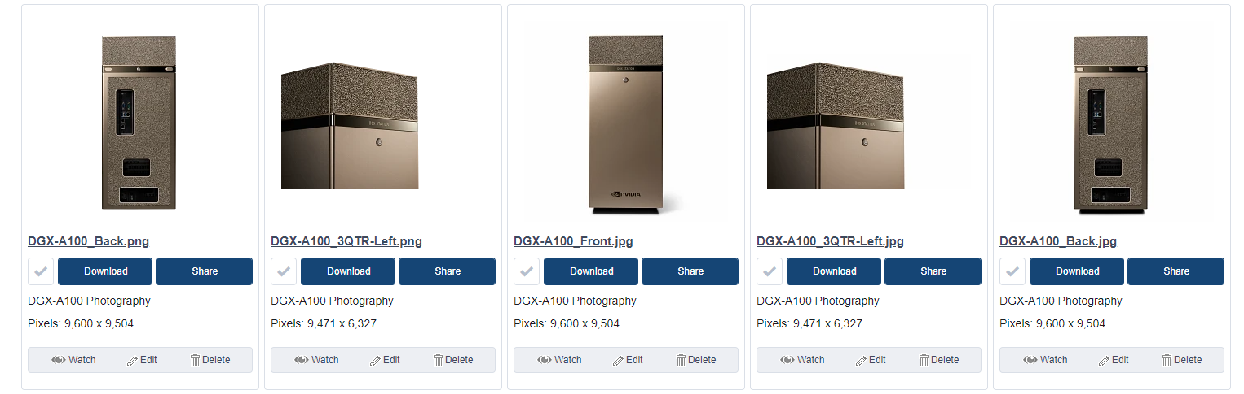
Images, Assets AND LOGOS
Available for Download at: NVDAM

Slide 69

Icons and Ampersands
ICON LIBRARY
AMPERSANDS
Available for Download at: NVDAM Icon Library
Change Ampersand from Trebuchet to Arial
&
&
Trebuchet
Arial

